Slide 1
Finding Similar Neighbourhoods in city of Toronto and New York

Slide 2
Why are we comparing the two cities?
To solve the problem defined below: Let's consider an employee that is currently working in an organization in New York City and he is promoted but is given a position in the same organization but in the city of Toronto.
So, thus he has to shift from one city to another. Now we all know how difficult or tedious it is to find a similar environment that you have been living in again. If this process is done manually it would take weeks of research and understanding of other cities, which concludes to be a very hectic task.
So to ease this process of shifting and finding a similar neighborhood in the city of Toronto we are going to use k-means machine learning algorithm to cluster the neighborhoods and Foursquare location data to explore a particular neighborhood to solve this problem easily.

Slide 3
Why comparing the two cities is valuable?
Generally, people tend to shift from one place to another. Therefore, finding places that are similar to earlier place is very crucial.
Also comparing two cities on the basis of venues or amenities present in their respective neighbourhoods helps us to find similarity score or index between two cities. Which helps us to quantify our statement such as : Is New York City more like Toronto or Paris or some other multicultural city?
It also helps us in answering the query such as : In a city of your choice, if someone is looking to open a restaurant, where would you recommend that they open it?

Slide 4
Data acquisition
New York City Data containing 5 boroughs and 306 neighborhoods with latitude and longitude values scraped from https://rb.gy/8vwmlf
Toronto City Data containing 10 boroughs and 217 neighborhoods scraped from https://rb.gy/ccpj06
Geospatial_Coordinates.csv containing latitude and longitude values for neighborhoods belonging to Toronto present at https://rb.gy/l2ufq3
Foursquare Location Data to explore most common venues in each neighborhood

Slide 5
Data Cleaning
Only processing the cells that have an assigned borough. Ignore cells with a borough that is Not assigned
Merging of dataframes to add latitude and longitude values for neighborhoods in Toronto
Appending dataframe and dropping any rows containing null values
Raw dataset contains 409 rows and 5 columns
Appending new columns and transforming dataframe as required
Final dataframe consists of 408 rows and 16 columns

Slide 6
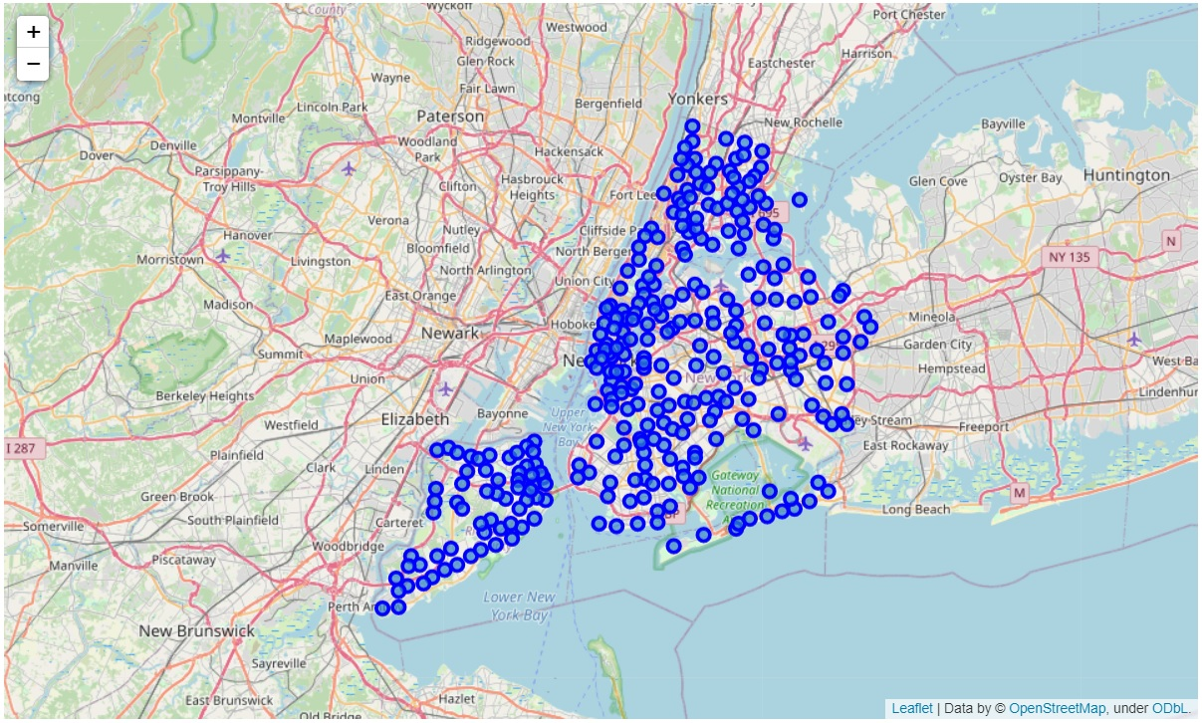
Map of New York city with neighbourhoods superimposed on top

Slide 7
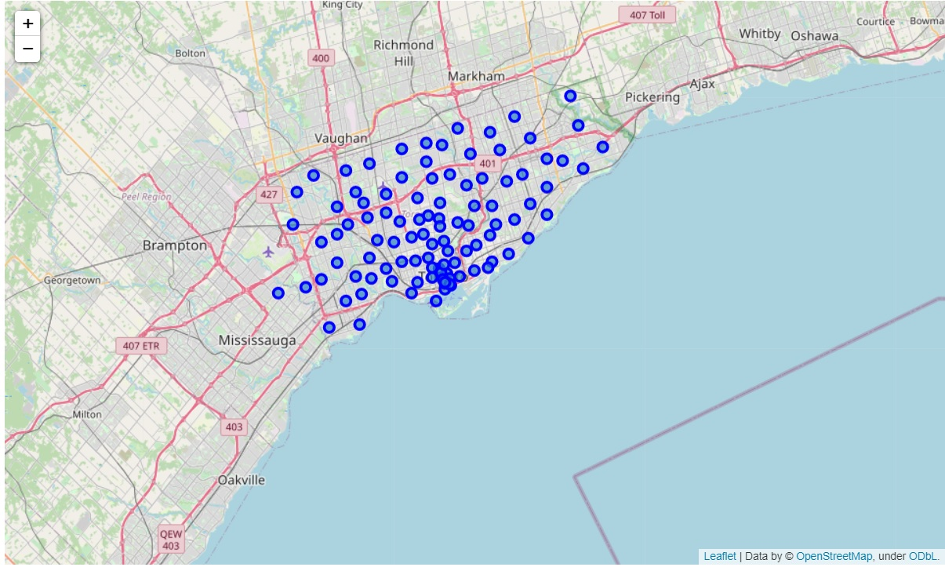
Map of Toronto with neighborhoods superimposed on top

Slide 8
Methodology
First we collected the data regarding every neighborhood in the city plus also collected their respective latitude and longitude values ,so as to explore those neighborhoods and to get top venues near them, on basis of which the entire clustering process will be performed.
Second step in our analysis will be to analyze each neighborhood, then to group rows by neighborhood and to find top 10 venues pertaining to each neighborhood by taking the mean of the frequency of occurrence of each category.
In the third and final section , we are going to use k-means clustering algorithm to segment and group neighborhoods.
Then we are going to visualize neighborhoods on the basis of clusters they are assigned to.

Slide 9
Foursquare Location Data
Here we are using Foursquare Location Data to explore the neighbourhoods and to get top venues near them , on the basis of which entire clustering process will be performed.
So to leverage the facility of Foursquare Location Data we have to use Foursquare API to send request to the server with our Foursquare credentials.
Example: url that is used to send request

Slide 10
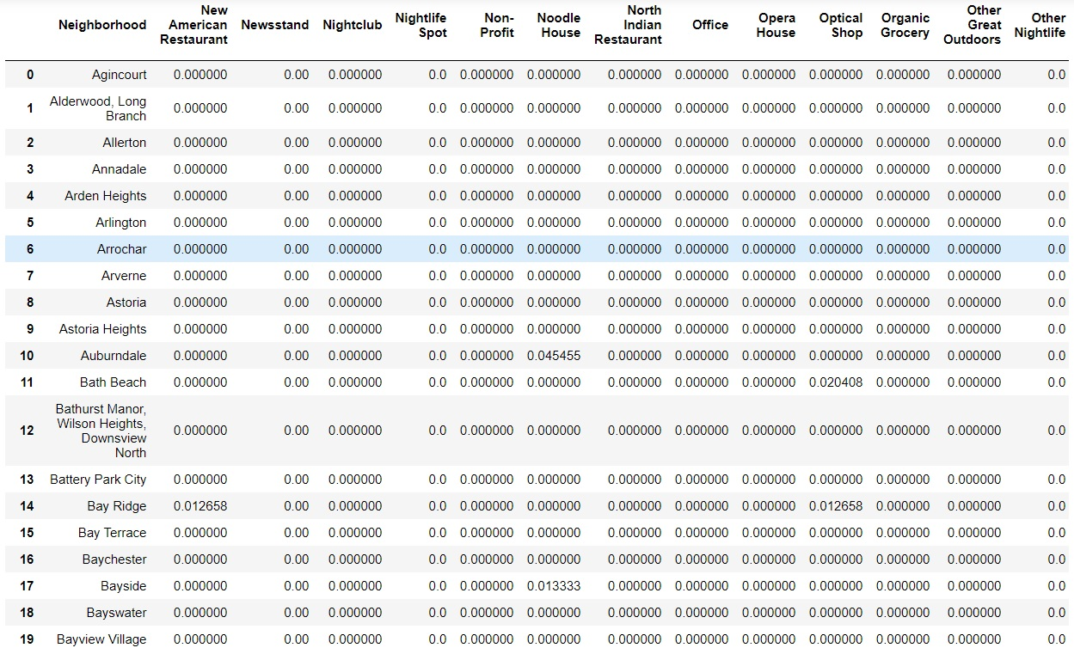
Dataset that is used for clustering

Slide 11
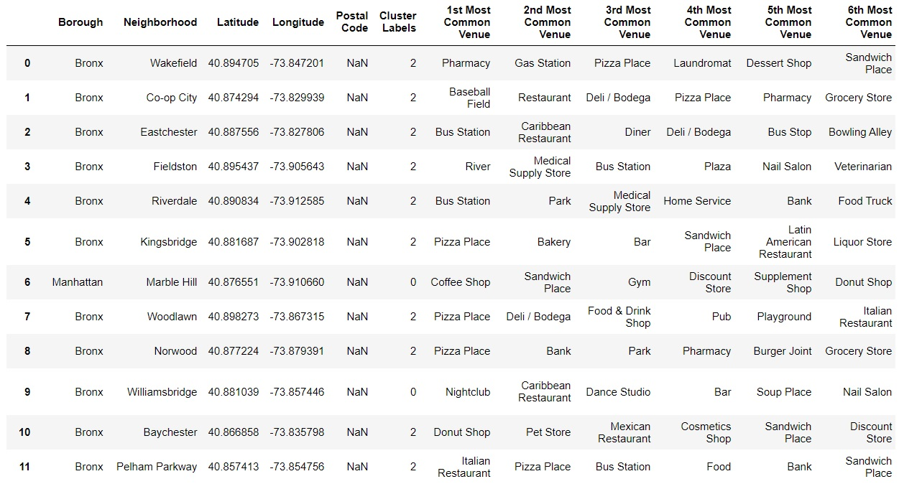
Final dataset consisting neighbourhoods with cluster labels and top 10 most common venues

Slide 12
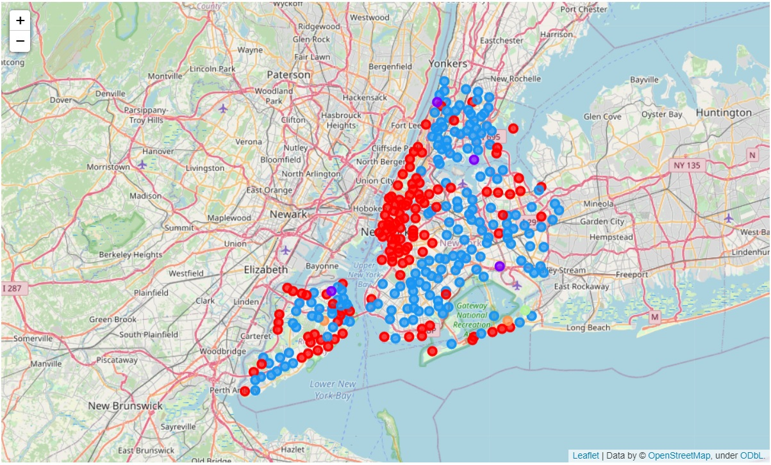
Visualizing clusters in New York City

Slide 13
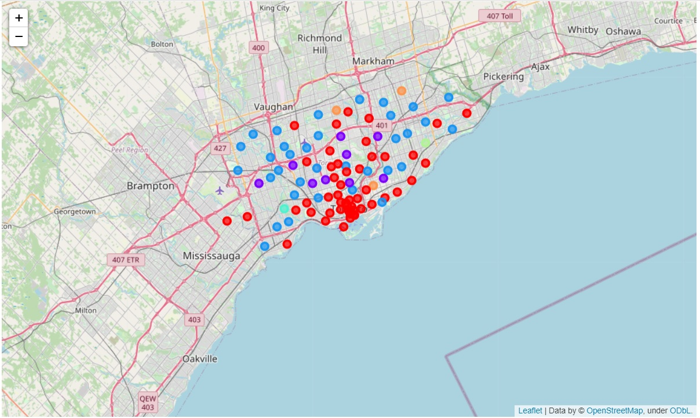
Visualizing clusters in Toronto City

Slide 14
Reasons why we are using k-means clustering algorithm are:
k-means is one of the simplest algorithm which uses unsupervised learning method to solve known clustering issues.
It works really well with large datasets.
Guarantees convergence.
Can warm-start the positions of centroids.
Easily adapts to new examples.
Generalizes to clusters of different shapes and sizes, such as elliptical clusters.

Slide 15
Conclusion
Finally we segmented and clustered all the neighbourhoods belonging to the two cities.
We used k-means clustering algorithm , with k = 6 ,i.e. all the neighbourhoods are clustered into six clusters on the basis of most common venues in the neighbourhoods.
Now we can select the neighbourhood that is similar to our current neighbourhood easily.
Final decision on optimal neighborhood will be made by end user based on specific characteristics of neighborhoods and locations in every recommended neighborhood taking ,into consideration additional factors like attractiveness of each location (proximity to park or water), levels of noise / proximity to major roads, real estate availability, prices, social and economic dynamics of every neighborhood etc.

